Slide 1

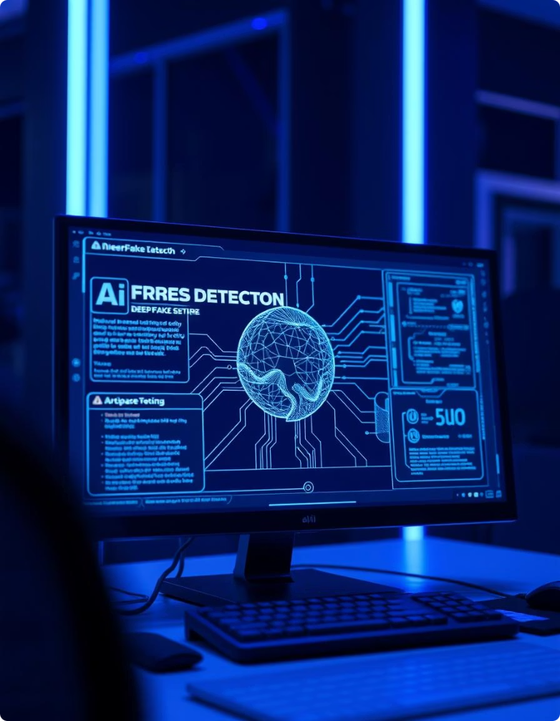
Deepfake Detection Using Meso4 Model and OpenCV
A Lightweight Machine Learning Approach for Identifying Manipulated Media
Presented by: [CodeCrackers]

Slide 2


Introduction to Deepfakes
What are deepfakes ?
Why are they dangerous?
Need for automated detection

Slide 3

Why This Project?
Meso4 combined with OpenCV offers effective detection.
Human detection is no longer reliable
Relevance in cybersecurity and media integrity
Chosen due to its technical challenge and societal impact

Slide 4
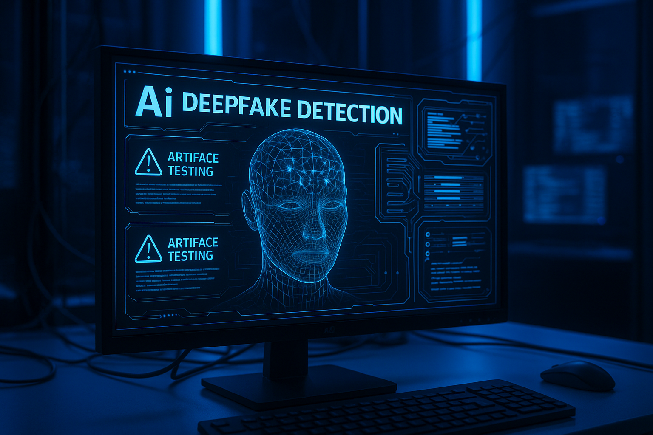
What the Market Wants
Lightweight, fast AI models
Real-time image/video authentication
Scalable tools for social media platforms
Tools usable by investigators and journalists

Slide 5
Problem Statement
Deepfakes are hard to detect manually
Existing tools are resource-intensive
Need for autoExisting tools are resource-intensivemated detection

Slide 6
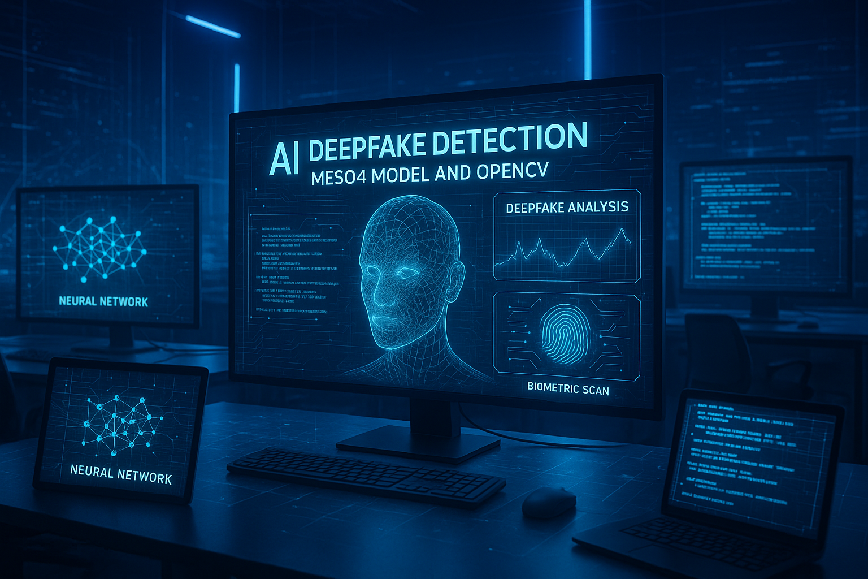

Project Objectives
Build a CNN-based deepfake classifier
Use Meso4 for feature detection
Integrate OpenCV for image processing
Provide real/fake label with confidence score

Slide 7


Dataset Used
➤ DFDC Dataset
➤ Real + Fake videos
We used the DFDC dataset published by Facebook and others.
It includes videos generated using AI and the real counterparts.
➤ Frame extraction
Each video was split into 20–30 image frames using OpenCV.
➤ 50 GB processed
Due to size constraints, we used a representative sample—enough
to train the model.

Slide 8

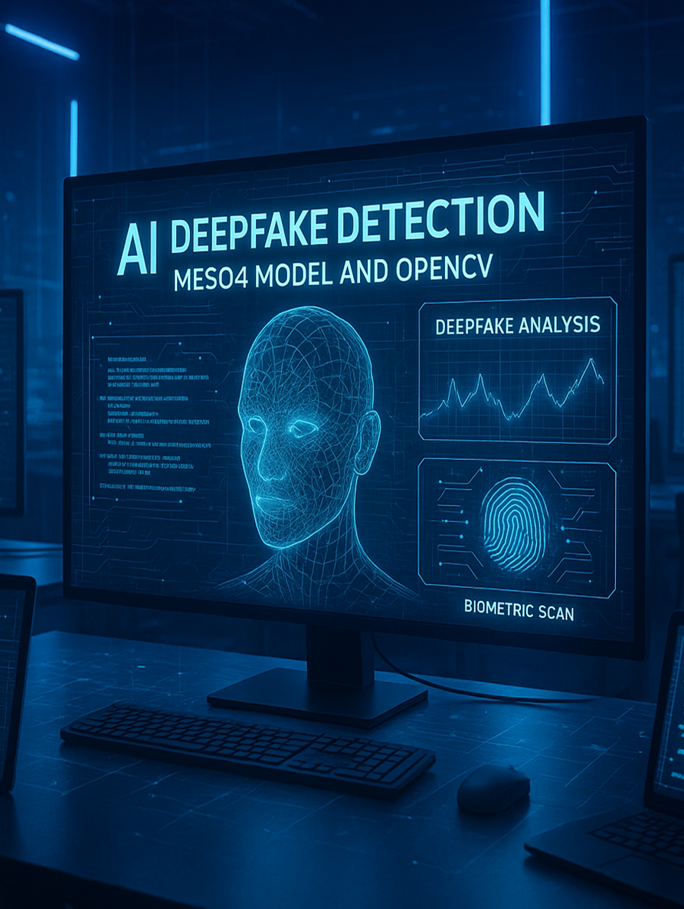
Meso4 Architecture
4 convolutional layers + 2 dense layers
Uses ReLU, BatchNorm, Dropout
Ends with Sigmoid activation
Designed for mesoscopic feature analysis

Slide 9
System Workflow
Input: Image or Video
Frame extraction with OpenCV
The user can provide an image or a video file.
For videos, we extract several frames using OpenCV.
Preprocessing (resize, normalize)
Meso4 model prediction
Each image is resized to 256x256 and normalized (pixel values scaled to 0–1).
Each frame is passed through the model for prediction.
Output: Real or Fake + confidence
System shows if the image is REAL or FAKE, along with a confidence percentage.

Slide 10
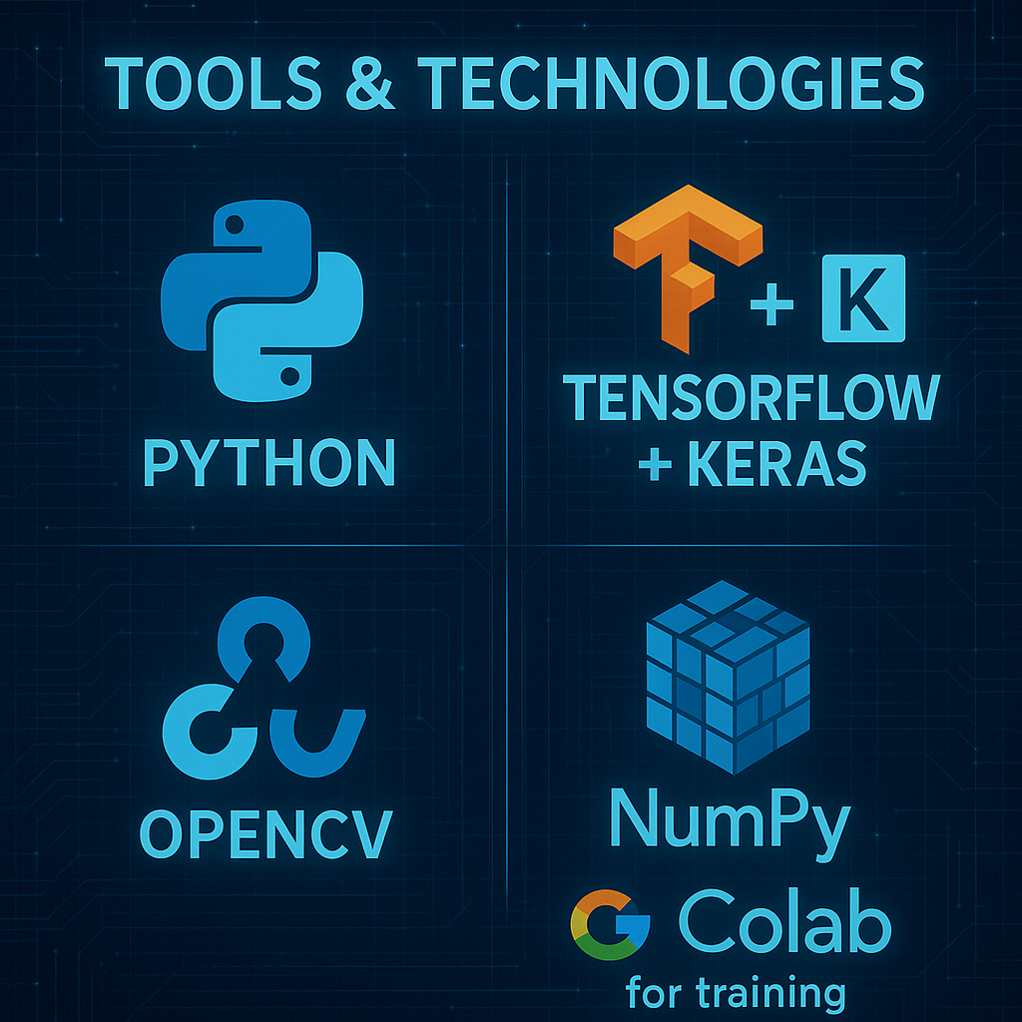
Future Scope
Add real-time webcam support
Build a GUI or web version
OpenCV
NumPy
Google Colab for training

Slide 11

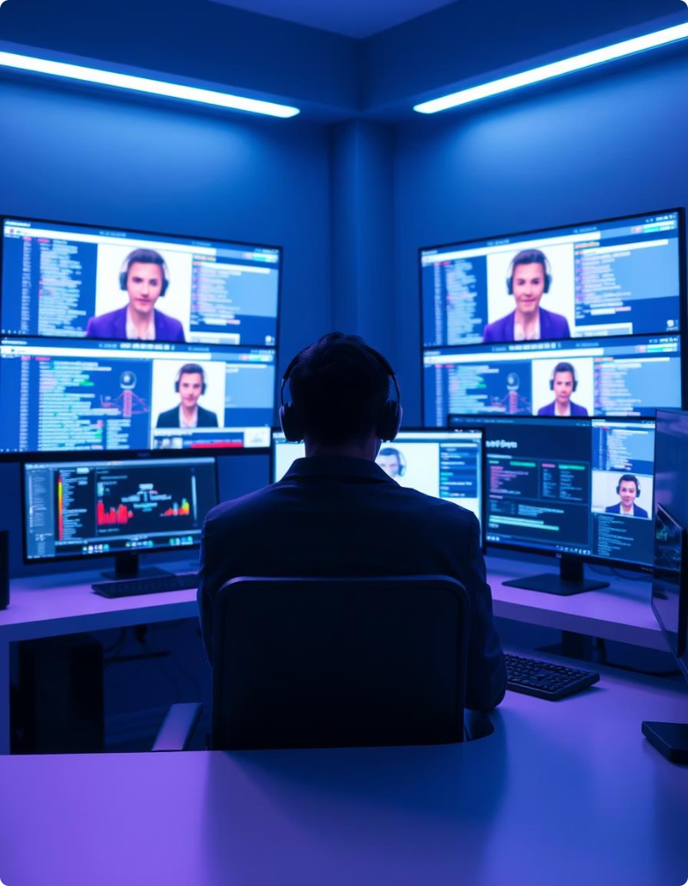
Sample Output
Add real-time webcam support
Output: FAKE
Confidence: 91.7%
Frame-wise consistency maintained

Slide 12

Challenges Faced
Class imbalance (more real than fake samples)
Poor-quality images reduced accuracy
Avoiding over fitting
Speed issues on large videos

Slide 13
Future Scope
Add real-time webcam support
Build a GUI or web version
Use facial landmarks (Dlib)
Train on larger, more diverse datasets

Slide 14
Conclusion
Meso4 + OpenCV is a practical solution.
Deepfakes are a serious digital threat
Our model is lightweight, fast,
and accurate
Ready to be expanded for real-world use

Slide 15


